Slide 1
Flux of Souls

Slide 2
Roles
Rudy Caliph – Scrum Master
Craig Rose – Developer
Randy Peacock – Developer
Richard Andrews – Developer
Stephan Dos Santos – Developer
Tobias Perez Davidson– Developer

Slide 3
Overview
Game Description
Changes and Project Issues/Problems
Pivotal Tracker Breakdown
UML Diagrams
Game Demonstration
Presentation of Solution
Q/A

Slide 4
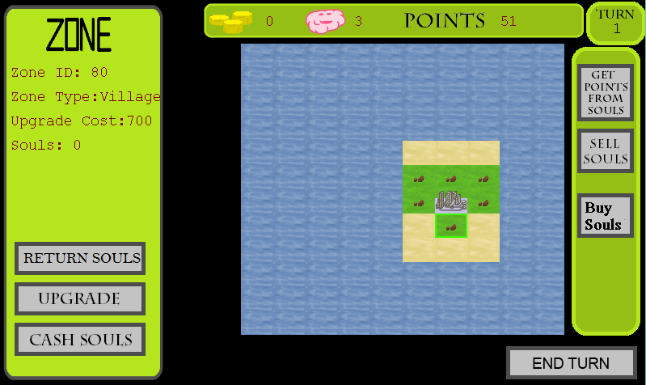
Game Description
Concept & Problem Statement
Gameplay

Slide 5
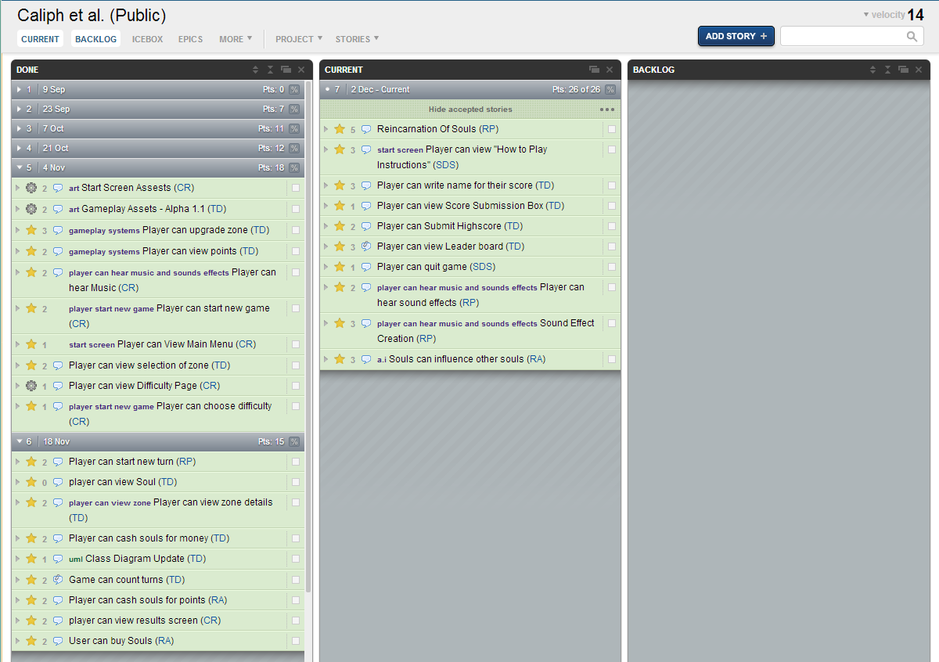
Pivotal Tracker
https://www.pivotaltracker.com/s/projects/908374

Slide 6
Changes and Project Issues
Povital Tracker
Git Hub Code Repository
Gameplay Balancing

Slide 7
Design And Analysis
Class Diagram
Use Case Diagram

Slide 8
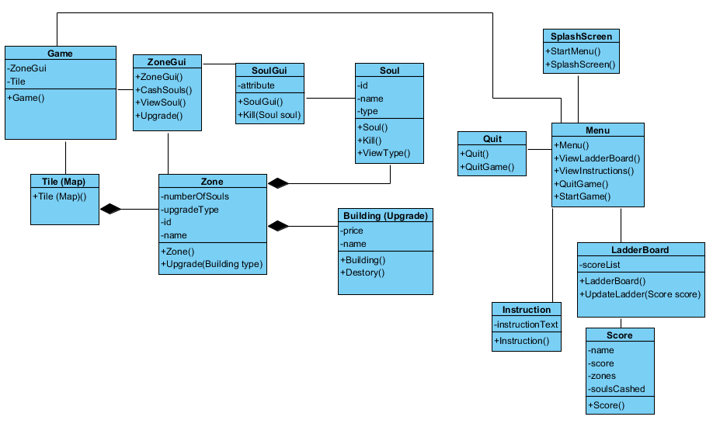
Class Diagram

Slide 9
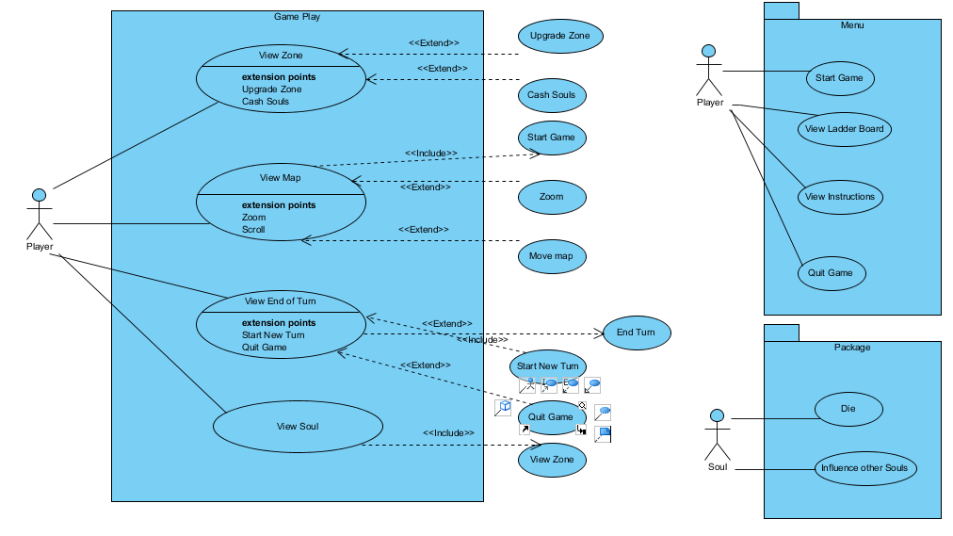
USE Case diagrams

Slide 10
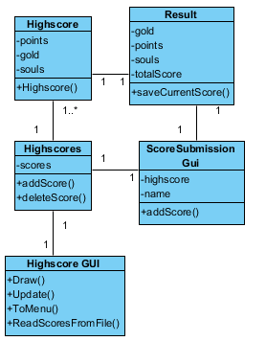
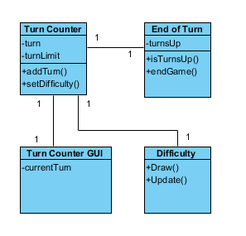
User story Class Diagrams

Slide 11

Game Demonstration

Slide 12
Presentation of Solution
We will now move on to the XNA Solution portion of the Presentation

Slide 13
Question / Answer
Any questions about the project?

Slide 14

Thank you for listening

